Slide 1

RUNGTA COLLEGE OF DENTAL SCIENCES & RESEARCH
TITLE OF THE TOPIC – TOOTH NOMENCLATURE
DEPARTMENT OF CONSERVATIVE DENTISTRY AND ENDODONTICS

Slide 2
Specific learning Objectives
At the end of this presentation the learner is expected to know ;
Core areas* | Domain ** | Category #
Different systems | Cognitive | Must know
Introduction | Cognitive | Must know
Categories | Cognitive | Must know
*Subtopic of importance
** Cognitive, Psychomotor or Affective
# Must know , Nice to know & Desire to know
( Table to be prepared as per the above format )

Slide 3
Content
• Types of Human Teeth
• Sets of Teeth
• Tooth Notation Systems
• Nomenclature of Tooth Surfaces
• Nomenclature Related to Dental Caries
• Nomenclature Related to Noncarious Defects of Teeth

Slide 4
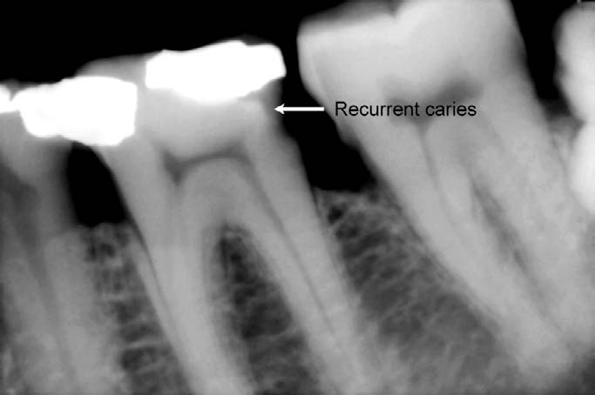
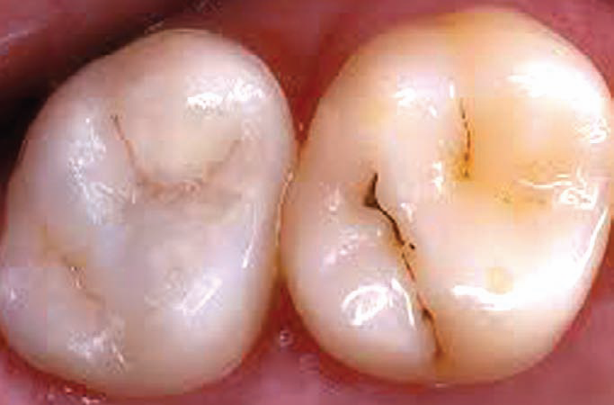
NOMENCLATURE RELATED TO DENTAL CARIES
Dental Caries
It is defined as a microbiological disease of the hard structure of teeth, which results in localized demineralization of the inorganic substance and destruction of the organic substance of the tooth.
Primary Caries
Denotes lesions on unrestored surfaces.
Secondary (Recurrent) Caries
Lesions developing adjacent or beneath existing restorations are referred to as ‘secondary’ or ‘recurrent’ caries.
Residual Caries
Demineralized tissue left in place before a restoration is placed. It can occur as a result of the clinician’s neglect or intentionally.
Dental caries

Slide 5
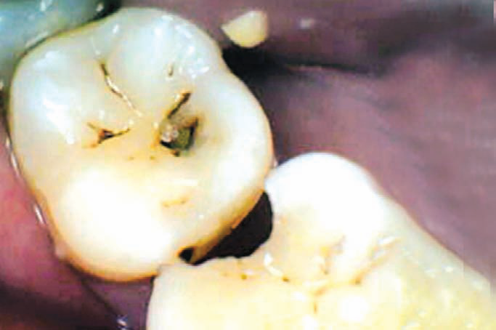
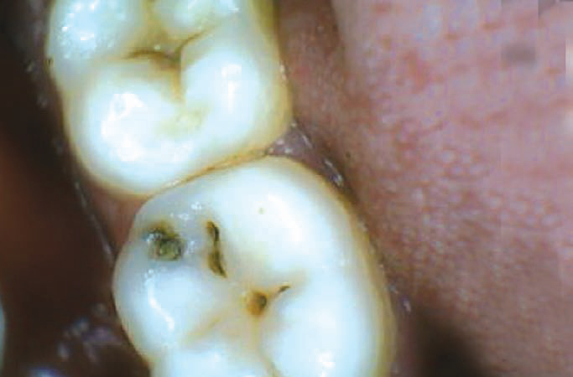
Active Carious Lesion
A lesion which is progressing is described as an active carious lesion.
Inactive/Arrested Carious Lesion
A lesion that has formed and then not progressed is referred to as an ‘arrested’ or ‘inactive’ carious lesion. Arrested carious lesions are often characterized by a large open cavities which no longer retain food and become self-cleansing.
Pit and Fissure Caries
Pit and fissure caries describes caries which occurs on occlusal surface of posterior teeth, buccal and lingual surfaces of molars and on lingual surfaces of maxillary incisors.
Smooth Surface Caries
Smooth surface caries occurs on the gingival third of buccal and lingual surfaces and on approximal surfaces.

Slide 6
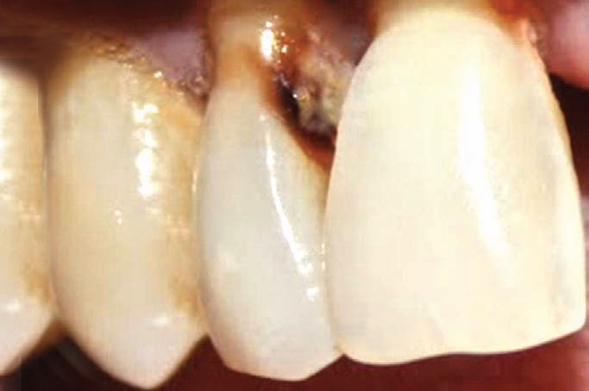
Root Caries
Root caries occur on exposed root cementum and dentin, usually following gingival recession:
Acute Dental Caries
Acute caries travels towards the pulp at a very fast speed.
Rampant Caries
The name given to multiple active carious lesions occurring in the same patient, frequently involving surfaces of teeth that are usually caries-free. Rampant caries can be of following three types:

Slide 7
Early childhood caries is a term used to describe dental caries presenting in the primary dentition of young children
Bottle caries or nursing caries is seen in the primary dentition of infants and young children as a consequence of sucking on a bottle or dummy containing cariogenic liquids. The clinical pattern is characteristic, with the four maxillary deciduous incisors most severely affected.
Xerostomia induced rampant caries is commonly seen after radiotherapy of malignant lesions of the jaws, as the salivary glands may be damaged by the radiation resulting in reduced salivary flow. Chronic Dental Caries
Chronic caries progresses very slowly towards the pulp. Such lesions appear dark in color and hard in consistency

Slide 8
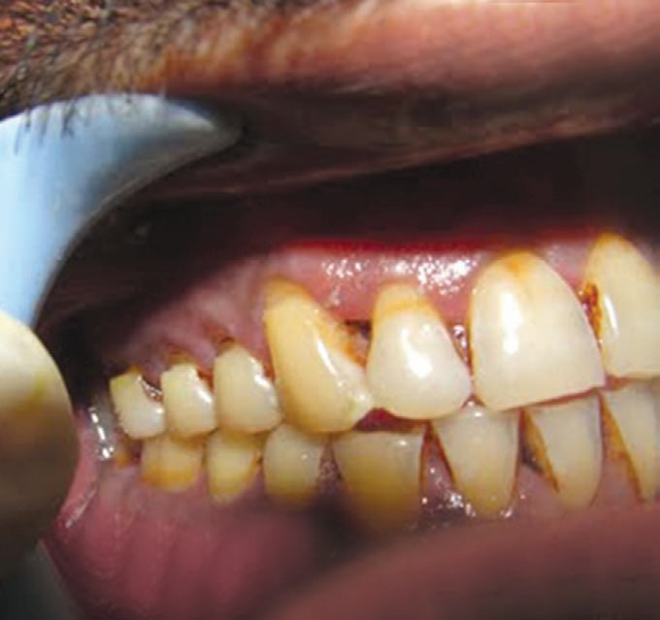
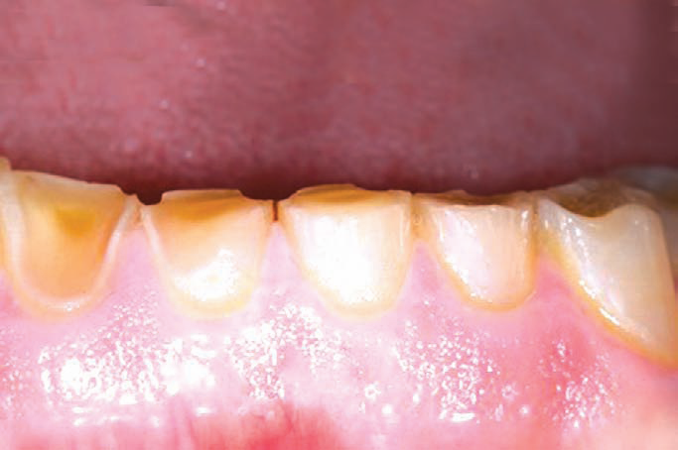
NOMENCLATURE RELATED TO NON CARIOUS DEFECTS OF TEETH
Attrition
It is defined as a physiological, continuous, process resulting in loss of tooth structure from direct frictional forces between contacting teeth. It occurs both on occlusal and approximal surfaces. Attrition is accelerated by parafunctional mandibular movements, especially bruxism.
Abrasion
It refers to the loss of tooth substance induced by mechanical wear other than that of mastication. Abrasion results in saucer-shaped or wedge-shaped indentations with a smooth, shiny surface.

Slide 9
Erosion
It can be defined as a loss of tooth substance by a chemical process that does not involve known bacterial action. The eroded area appears smooth, hard and polished.
Abfraction
Abfractions are the microfractures which appear in the enamel and possibly the dentine caused by flexion of the cervical area of the tooth under heavy loads.Abfraction lesions usually appear as wedge-shaped defects with sharp line angles.

Slide 10
Resorption
‘Resorption’ is defined as “a condition associated with either a physiologic or a pathologic process resulting in the loss of dentin, cementum or bone.” If resorption occurs, it is often because of some pathological process, although deciduous tooth roots undergo physiological resorption in order to be shed.
Localized Nonhereditary Enamel Hypoplasia
Refers to the localized defects in the crown of the portion tooth caused by to injury to ameloblasts during the enamel matrix formation stage.
These lesions may appear as isolated pits or widespread linear defects, depressions or loss of a part of the enamel.
Injury to ameloblasts may be caused by:

Slide 11
Traumatic intrusion of deciduous teeth
Fluorosis
Exanthematous diseases
Deficiency of vitamins A, C or D
Hypocalcemia.
Localized Nonhereditary Enamel Hypocalcification
Refers to localized defects in the crown of a tooth due to injury to the ameloblasts during the mineralization stage.
In these defects, the enamel is normal in structure but its mineralization is defective.
The color of lesion varies from chalky to yellow, brown, dark brown or grayish.

Slide 12
TAKE HOME MESSEGE/ FOR THE TOPIC COVERED (SUMMARY)
There are different tooth notations for identifying specific tooth.
The three most commons systems are
the “FDI World Dental Federation” notation,
the “Universal” system and
the “Zsigmondy-Palmer” system.
The FDI system is used worldwide and the universal is used predominantly in the USA.

Slide 13
Question & Answer Session
Zsigmondy Palmer system.
Universal tooth nomenclature.
Short note on FDI system of tooth nomenclature.

Slide 14
REFERENCES
NAME OF THE BOOK WITH EDITION AND PAGE NUMBERS
ARTICLE ARE TO BE MENTIONED IF NEEDED
Wheeler’s Dental Anatomy, Physiology and Occlusion- 10th Edition

Slide 15
THANK YOU

